Slide 1



National Autonomous University of Mexico
School of Engineering
Database’s project

Slide 2
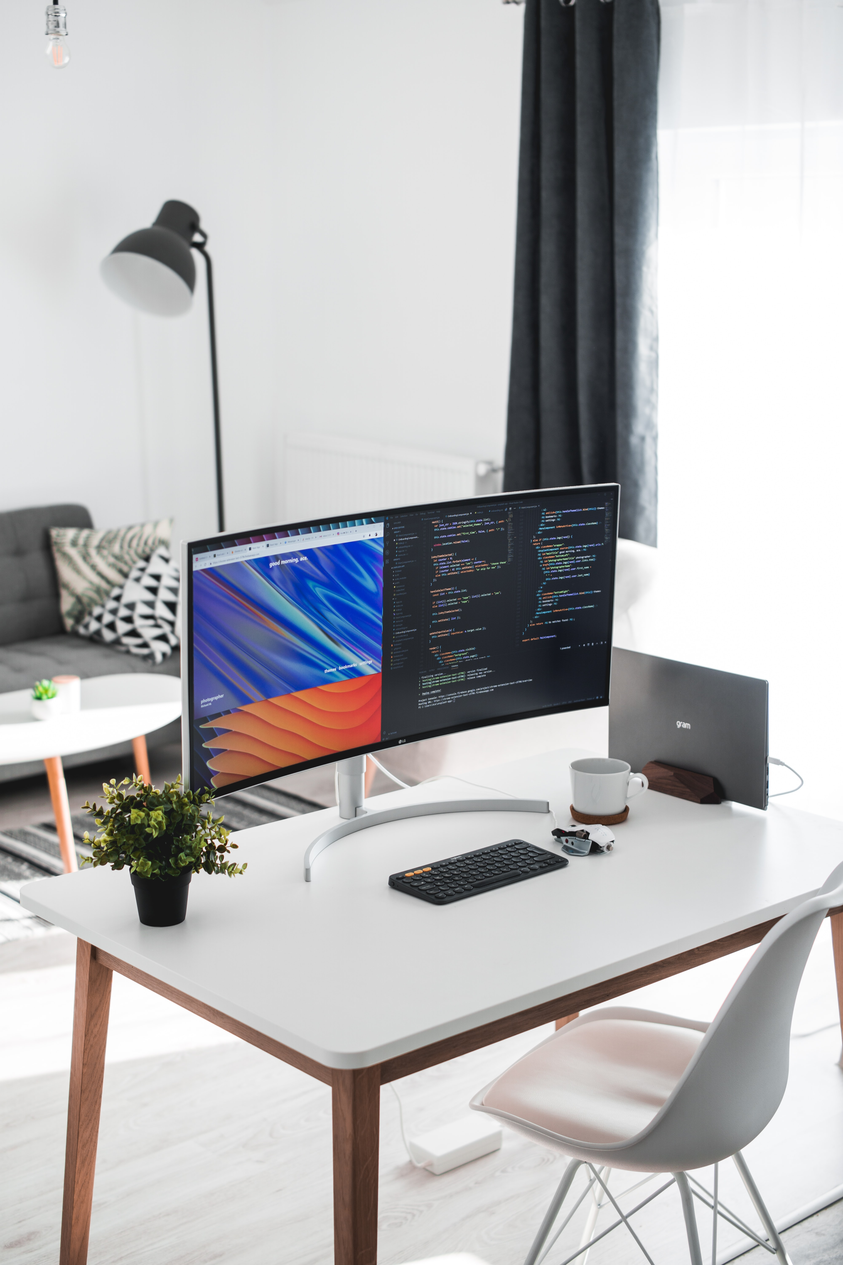
OFFICE SALE PROJECT
GEANT Consulting

Slide 3

About us
GEANT Consulting is a company with focus among software development, planning and design of technological structures, and information technologies projects. We have presence in all Mexico, Canada, USA and Latam.

Slide 4

Business line of our client Fernando Arreola
Business line needs database system to optimize internal process among management and accounting areas
Database must be simple, and their use be efficient
All main requirements be granted by quality and GEANT’s compromise

Slide 5

Our work team

Slide 6
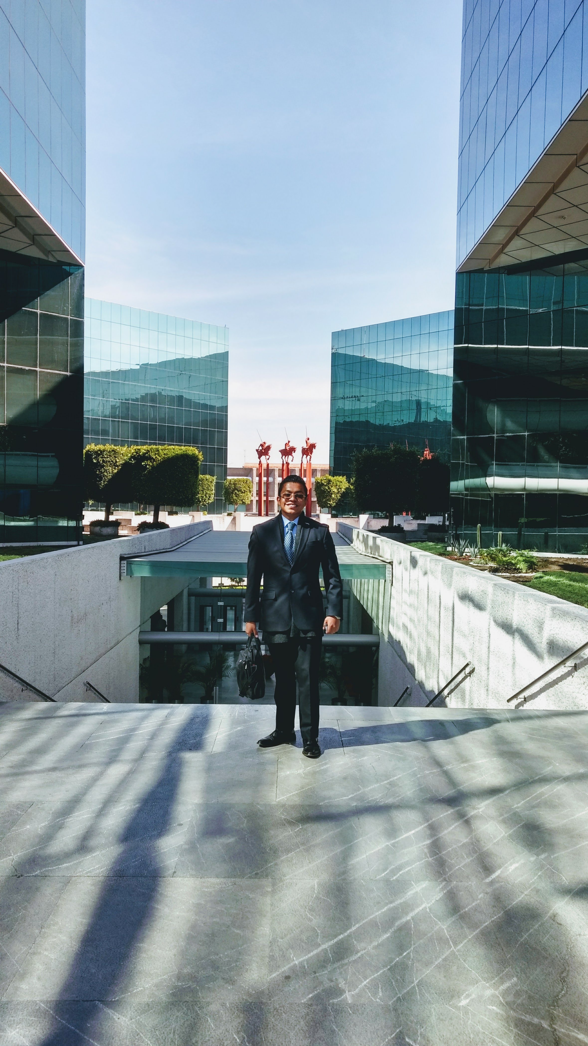
Daniel A. Zarco Manzanares (CTO & Project Manager)
Daniel has work trajectory as leader in organizations and work’s team through implementation of best lead techniques. He has worked as Chief Technology Officer in Banking sector and has collaborate with financial projects in different organizations. Now is C.T.O. in GEANT Consulting where his focus is quality, and bring value to clients and companies, with their projects.

Slide 7

Gabriela Gaytan Medina (Database Analyst)
She’s one best of database analyst in GEANT Consulting. She has a successful trajectory as computer engineer. She has worked as Developer in hardware projects, database designer, modern digital designer. She has a fundamental vision to work, investigation and implementation. If she don’t have knowledge of some concept, first she investigate to continues with implementation.

Slide 8
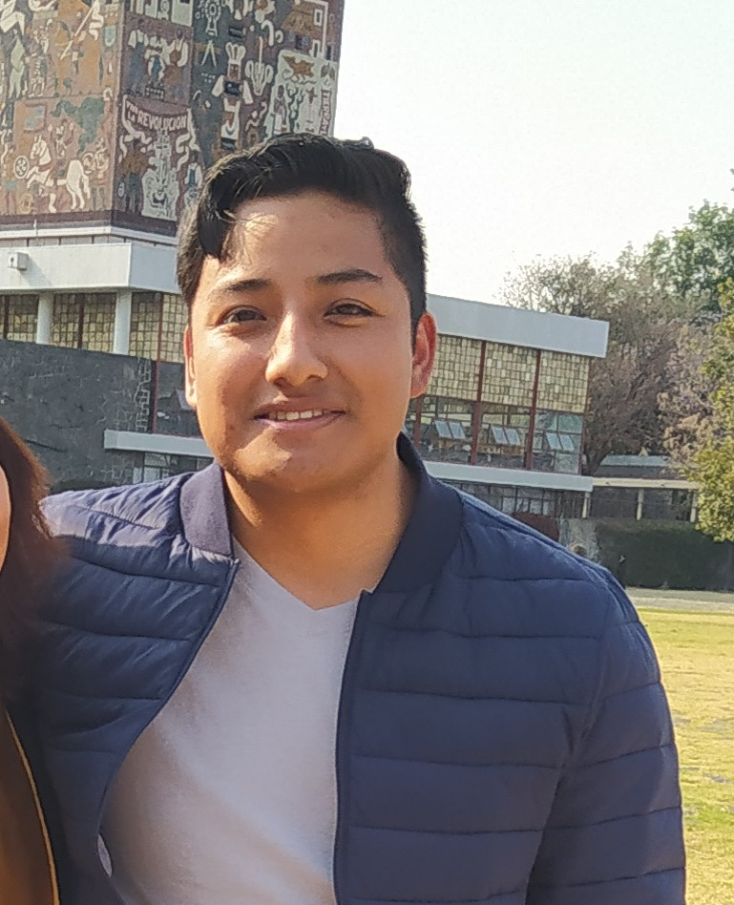
Omar Hernandez Francisco (Web Built Officer)
He have two fundamental skills in web built, first have knowledge in front end, optimizing simple web design and second, backend where connections among different devices are very simple. Continuously he investigate new forms to optimize all technologies in GEANT Consulting. Hard focus work is their philosophy in our business.

Slide 9

Josué David Rivera Arellano (Development Analyst)
He have work trajectory through development, his development skills have a variety on software development, database analysis, algorithm design and hardware optimization. Also he have skill in automata design, specially compiler applications.

Slide 10

Simple is nice
GEANT CONSULTING

Slide 11

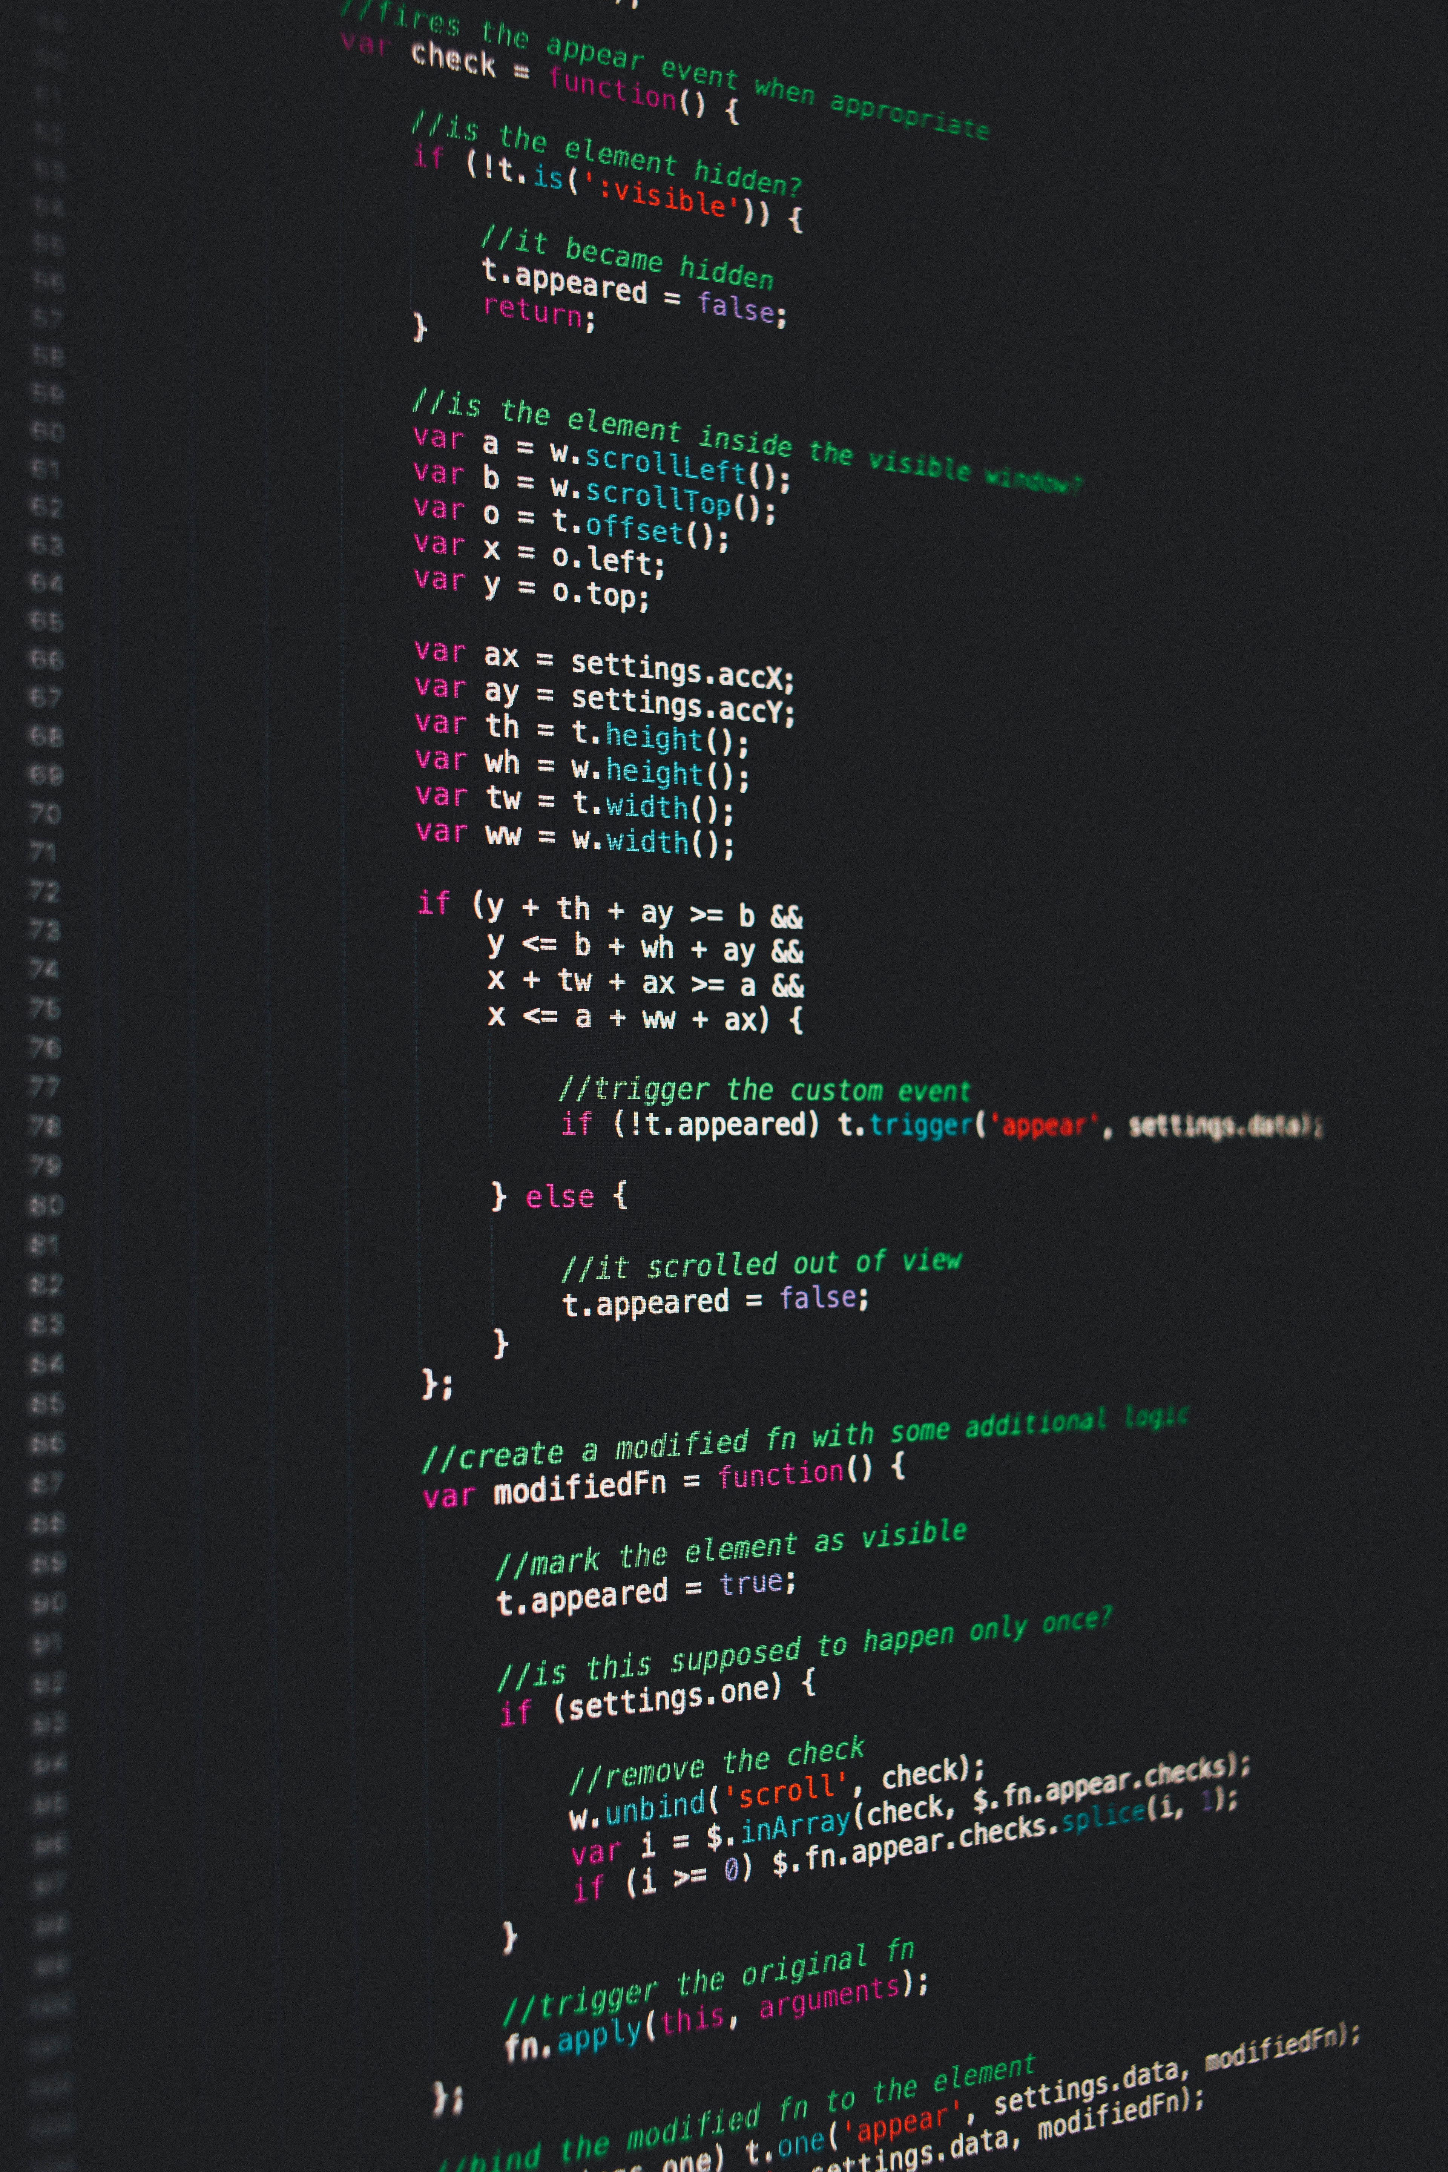
Requirements
Our requirements are:
When arrive product's bar code, shows the product's utility.
When registered a sale, must decrease the stock if product's stock is greater than 3 pieces, if product's stock is equal 3 pieces, must return a warning notifying to client that stock is equal 3 pieces or less, and if product’s stock is zero, notify an error and stop the sale.
Get the product's name which stock is less than three pieces.
Generate view to show necessary information to be equal a bill.
Create at leas one index and justify the reason to create that index in
these place.

Slide 12
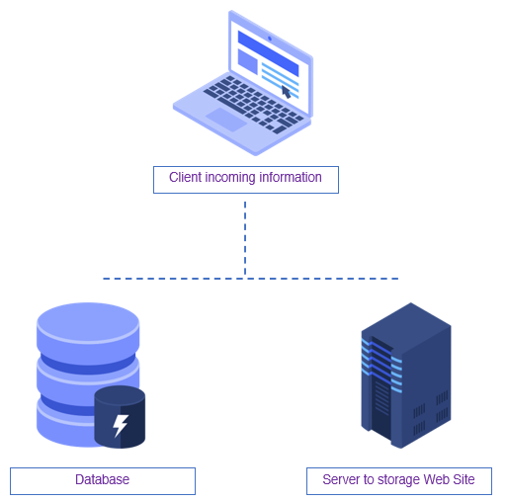
Database’s structure
Our structure's design has single computer that have dual function, as server where every send request arrive at server. Second function as data base, where has stored all information about the business line and internal process.
Server: Server provide stored data of web site, where we can manipulate in simple form all data generated by information’s flow. We use server with local area network(LAN).
Database: Developed across client's requirements, database can store all information of business line structure. Client's information, sale's transactions, providers information and complete data around at products.

Slide 13
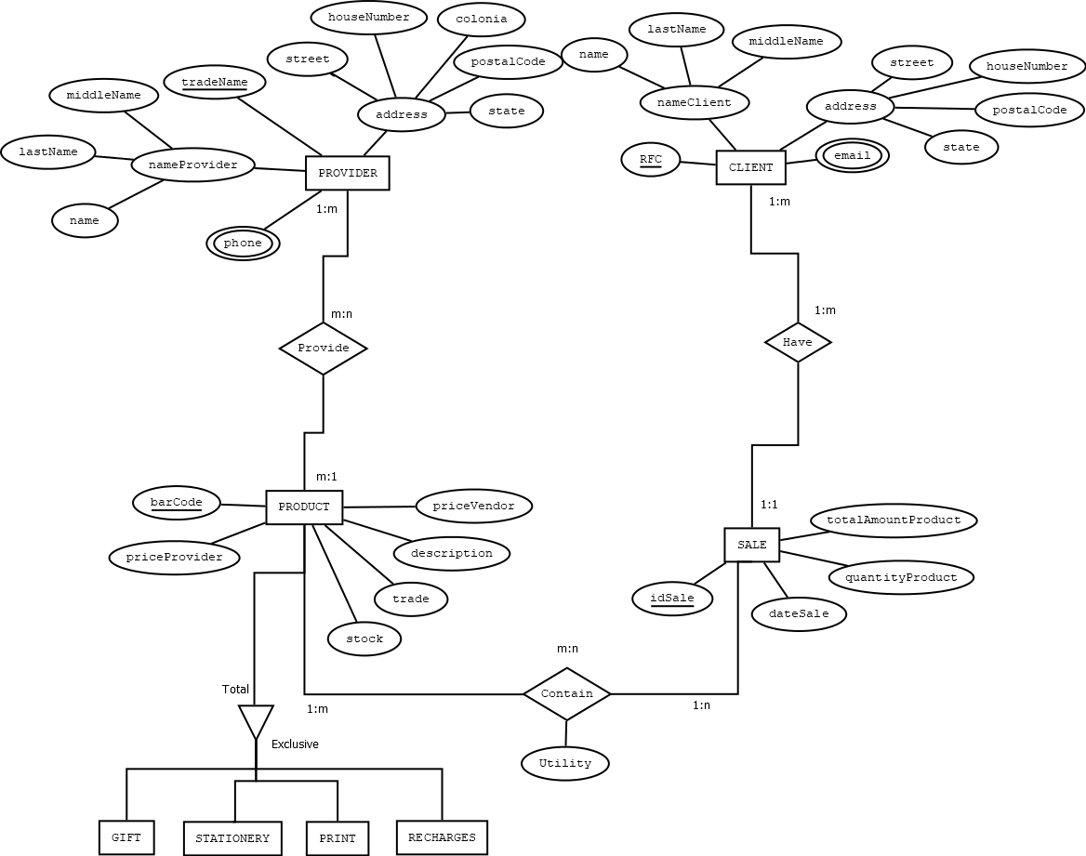
Entity Relationship Model
Following all requirements of our client, for more details consult project document in GitHub, on GEANT folder

Slide 14
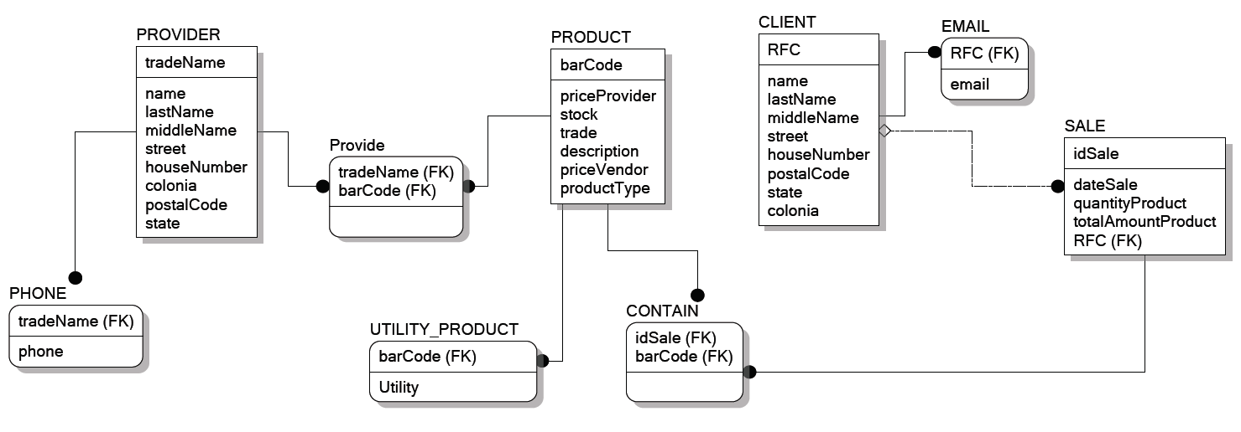
Relationship Model

Slide 15
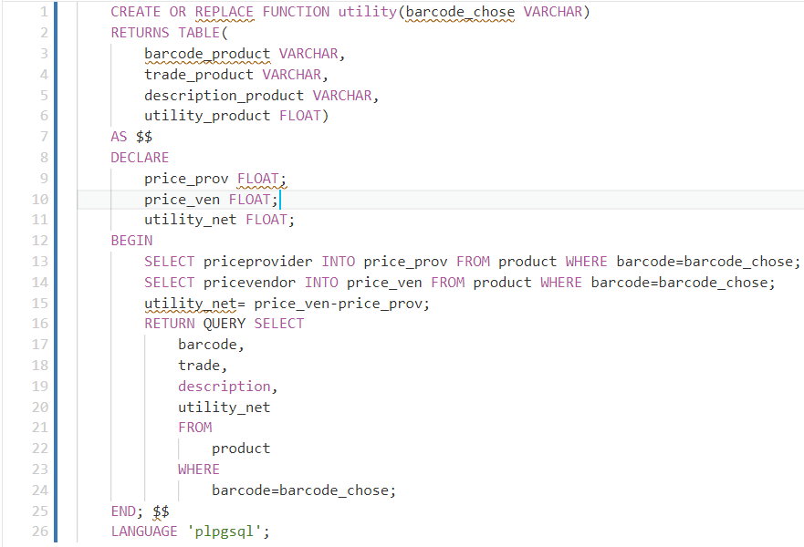
Utility by product's bar code

Slide 16
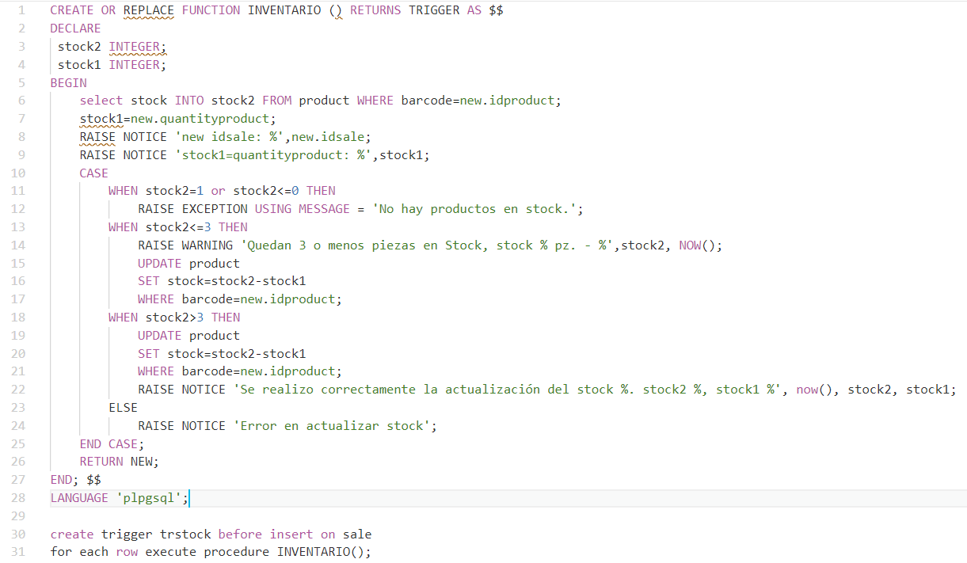
Updating product's stock while transaction's process is running

Slide 17
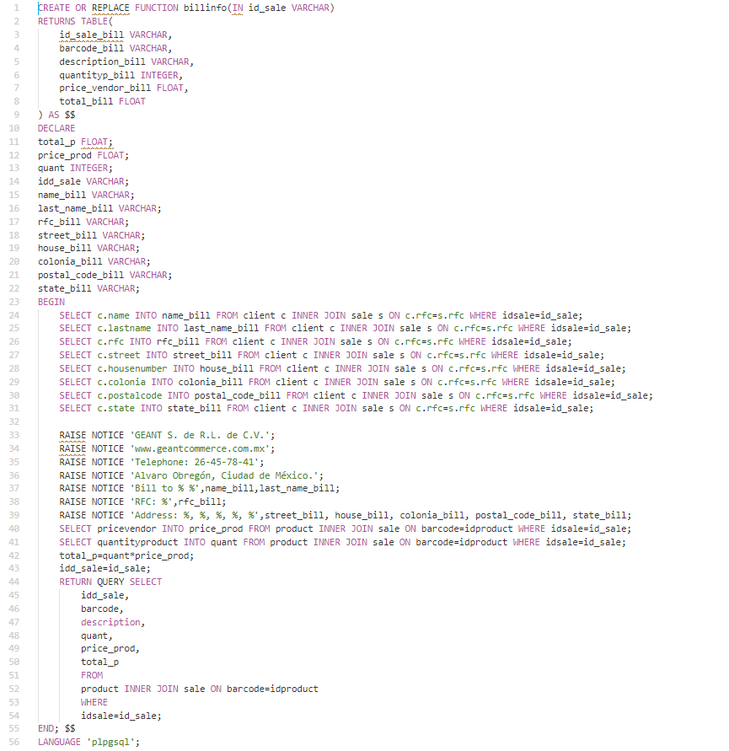
Generation of bill view
Income idsale parameter

Slide 18
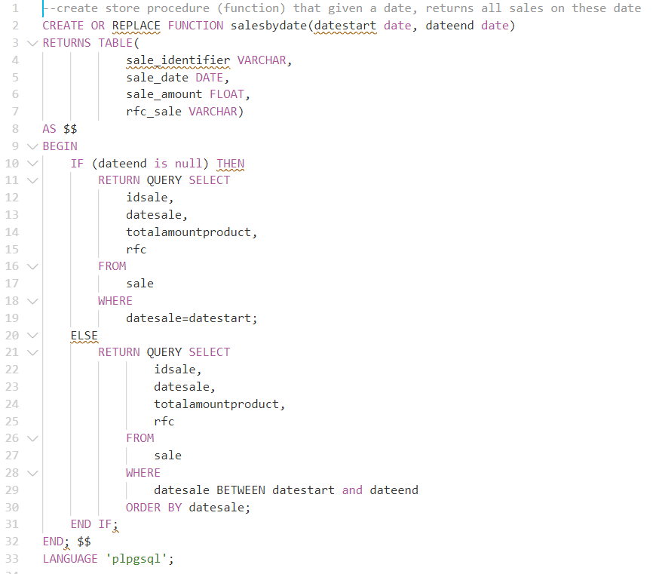
Shows sales on date range
Shows all sales on date range, can receive one or two parameters

Slide 19
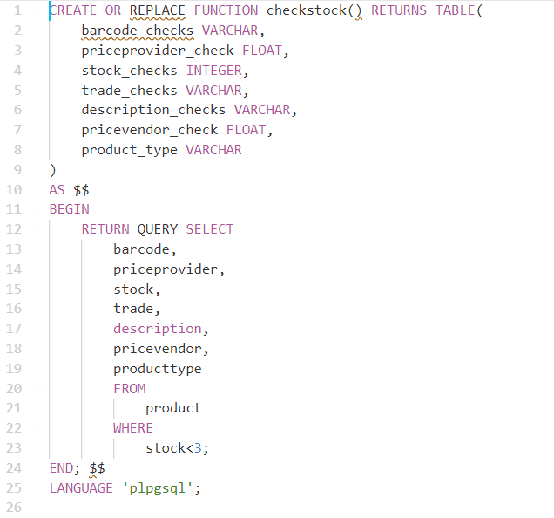
Check product’s stock less than three pieces
Give us all products where stock is less than 3 pieces

Slide 20
Create index to optimizing searching on database
create index indiceventa on
sale (idsale)

Slide 21


Web built
Server
We use Xampp as config local computer as server. For the connection of our database with the web interface, it was necessary to use the Xampp software, which is a server with Apache distribution which will be in charge of making a connection between the database in Postgresql and php.
Web page
For designing web page we using php, css and xampp environment. Web page have a login screen, if login is success we passed to main page of stationery business. If not passed, we can register and continuous

Slide 22
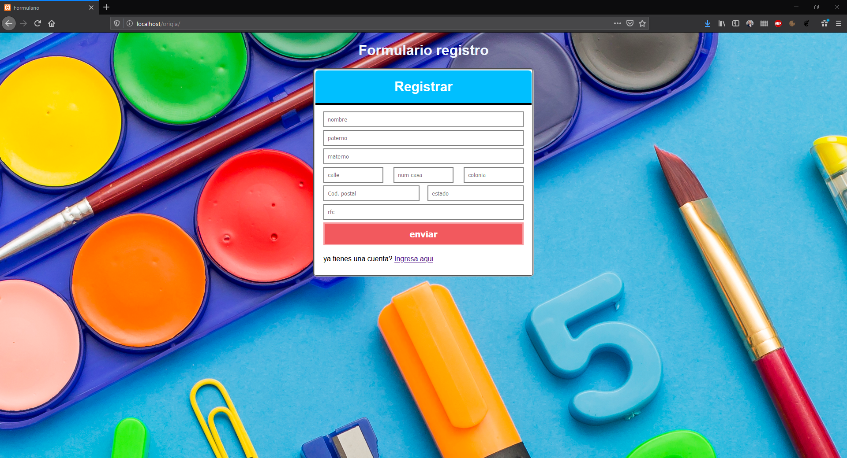
Sign up form

Slide 23
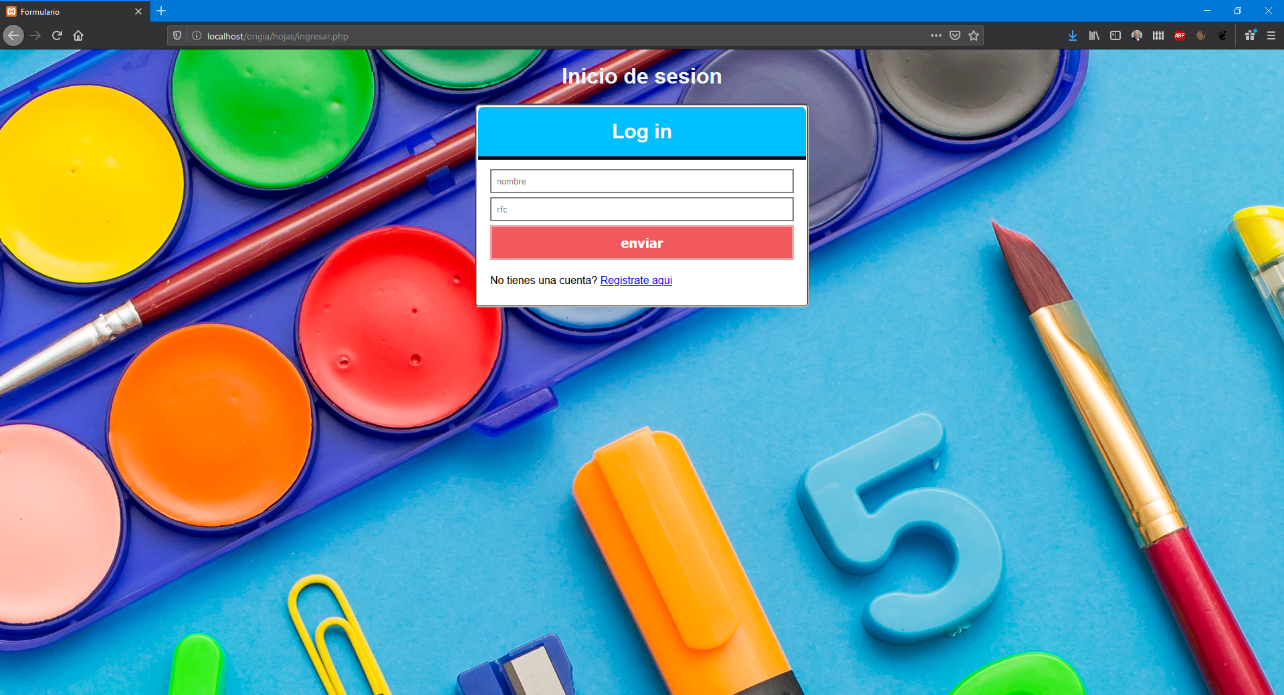
Sign in form

Slide 24
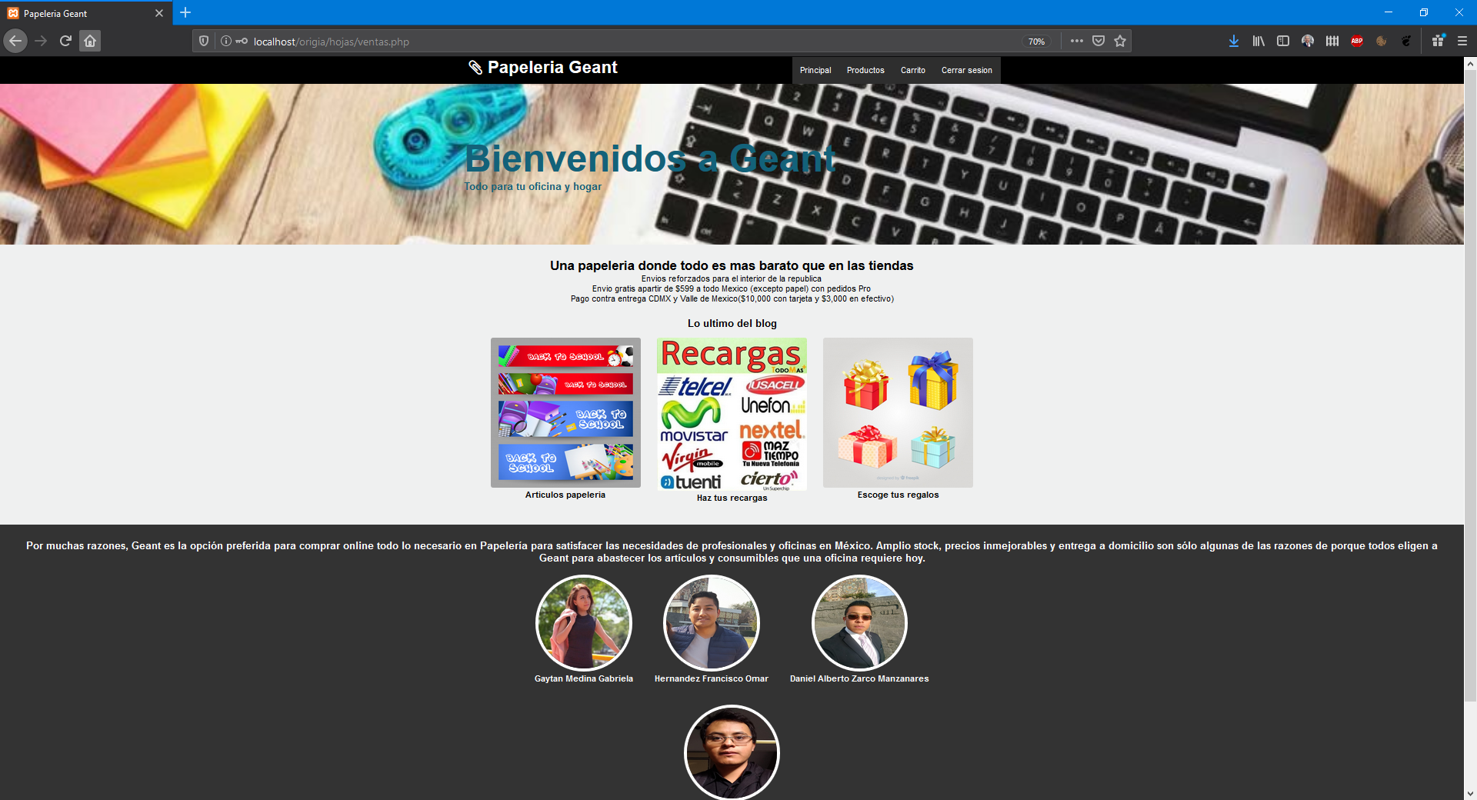
Main page of web

Slide 25
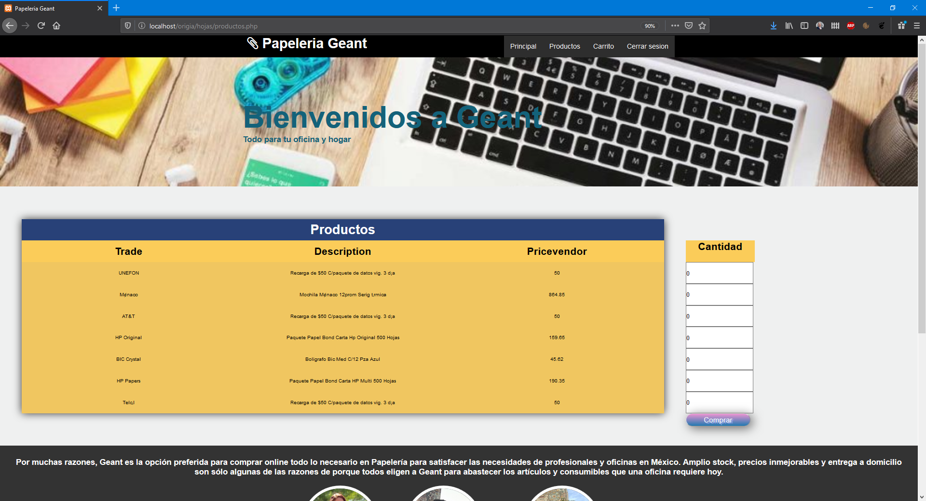
Sale page

Slide 26
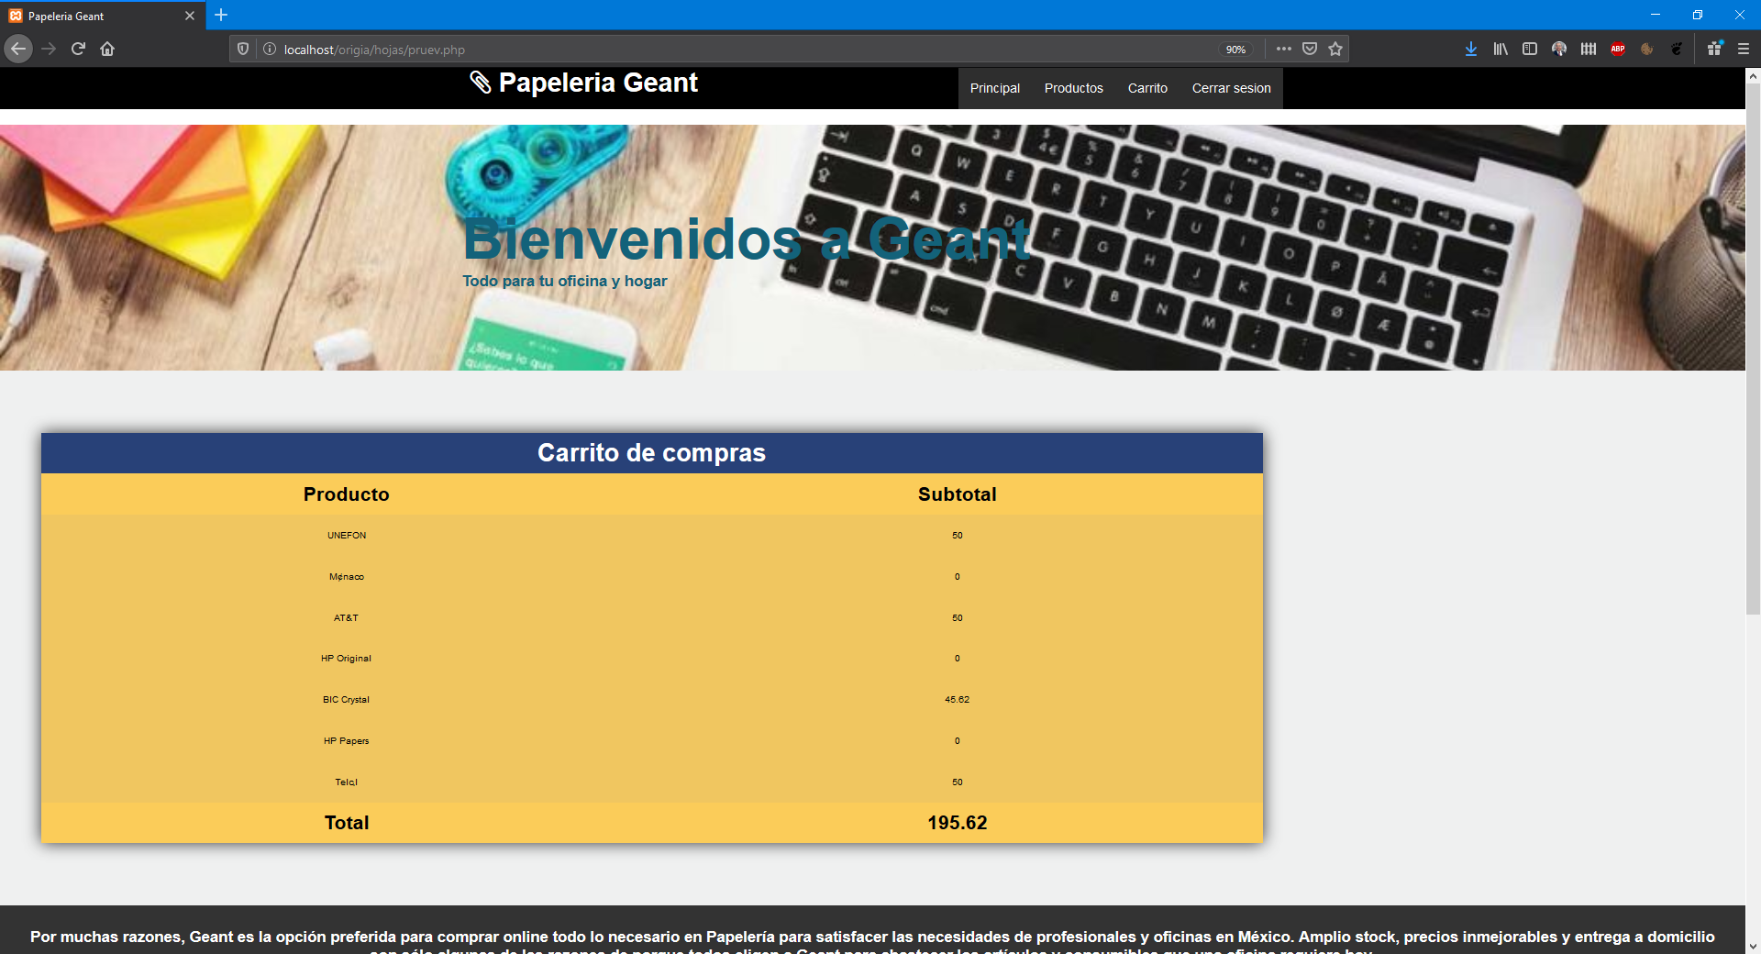
Sale transaction example

Slide 27




Our results
Our project generates value and growth
Quality is our priority
Our clients be part of GEANT
Our process are parallels from design at implementation

Slide 28

THANKS FOR YOU ATENTION
Daniel A. Zarco Manzanares
Gabriela Gaytan Medina
Omar Hernandez Francisco
Josué David Rivera Arellano
Chief Technology Officer & Project Manager
Database Analyst
Web Built Officer
Developer Analyst

